Slide 1
Biometric attendance system using fingerprint module
Presented by:
Dipak P. Sawalkar

Slide 2
Contents
Introduction
Review of Literature
Objectives
Methodology
Circuit Diagram
Result
References

Slide 3
Introduction
A biometric attendance system is a system that uses biometric data, such as fingerprints, to track student attendance.
Biometric data is unique to each individual, making it a very secure way to track attendance.
In proposed system, we make system where we use optical fingerprint sensor to get student biometric for attendance.

Slide 4
Review of Literature
V. Yadav et. al [1] proposed ideas using fingerprint is to build a separate device using IoT. A combination of the fingerprint sensor, a WIFI module, a keypad and an LCD display connected to a raspberry pi which acts as a processor. This acts as a stand-alone device and must be carried to every class with which attendance can be taken.
A. Chomklin et. al [2] proposed a system, QR code is the fastest way to authenticate digital data. Implementing this in an attendance system would allow the students to scan QR code on their mobile to mark attendance. The major disadvantage is that this code must be generated for every class and should be displayed to students. Also, the students can exchange the credentials and scan the QR code for another student. The QR code itself can also be shared and be misused.

Slide 5
Objectives
To replace manual attendance tracking methods, such as paper-based registers or swipe cards, with an automated system.
To achieve long-term cost savings by eliminating manual attendance tracking processes and reducing administrative efforts.
To eliminate time theft practices such as buddy punching or proxy attendance.

Slide 6
Methodology
Enrollment: This is the process of creating a biometric profile for each employee. The employee's fingerprint is scanned and stored in the system.
Attendance tracking: When an employee arrives at work, they place their finger on the fingerprint scanner. The scanner captures the employee's fingerprint and matches it to the fingerprint stored in the system. If the fingerprints match, the system records the employee's attendance.

Slide 7
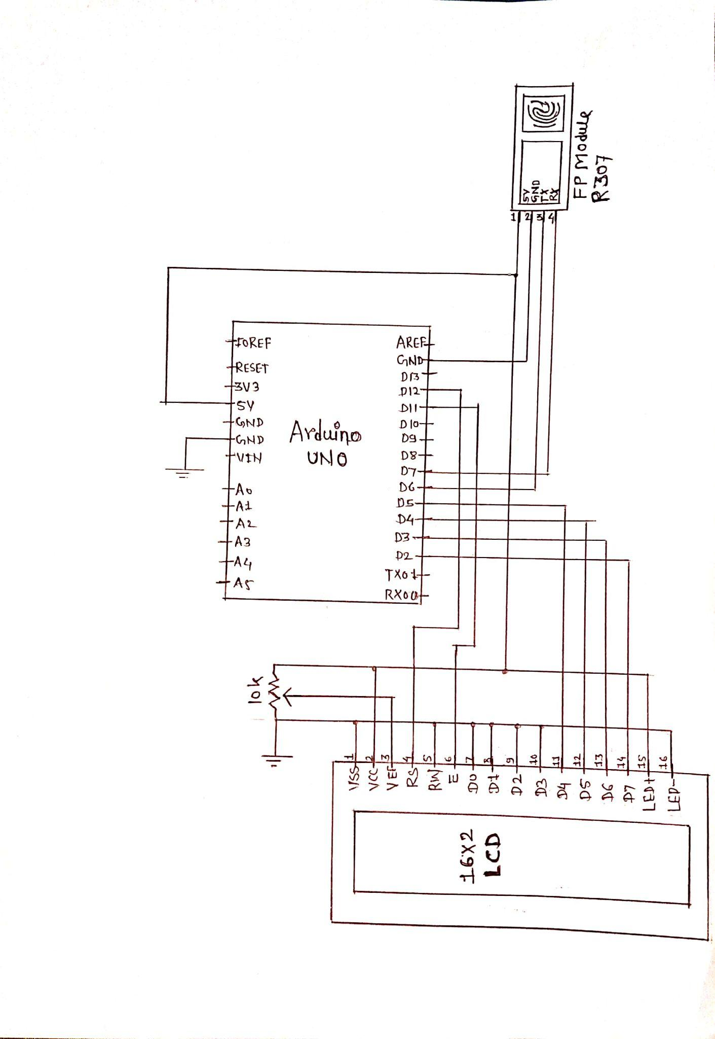
Circuit Diagram

Slide 8
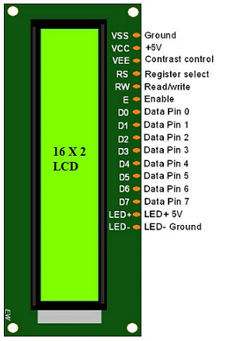
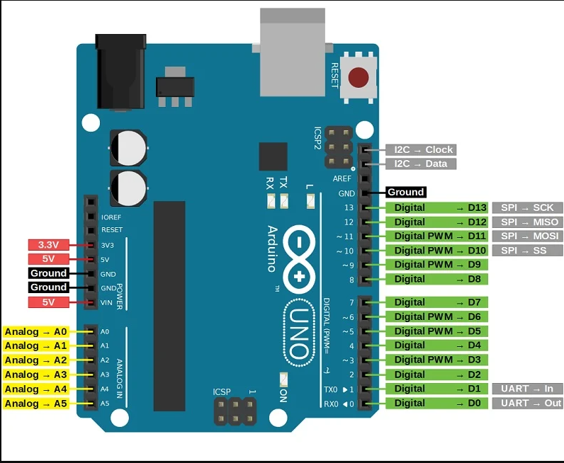
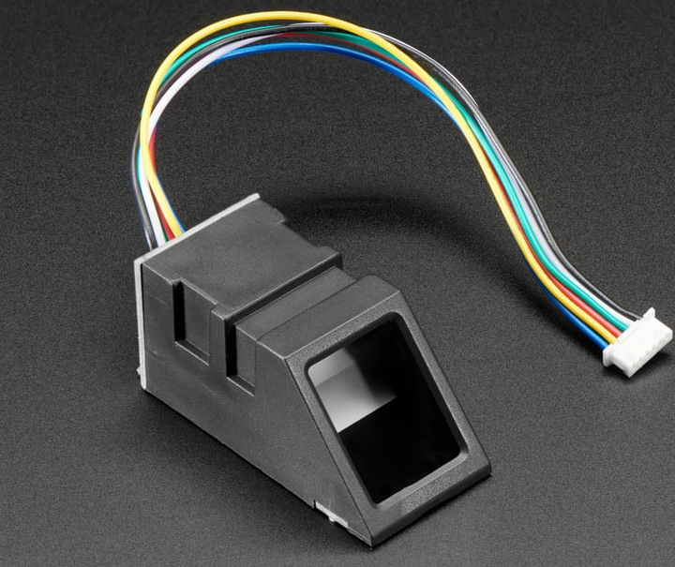
LCD (16*2) Arduino Uno R307 Sensor

Slide 9
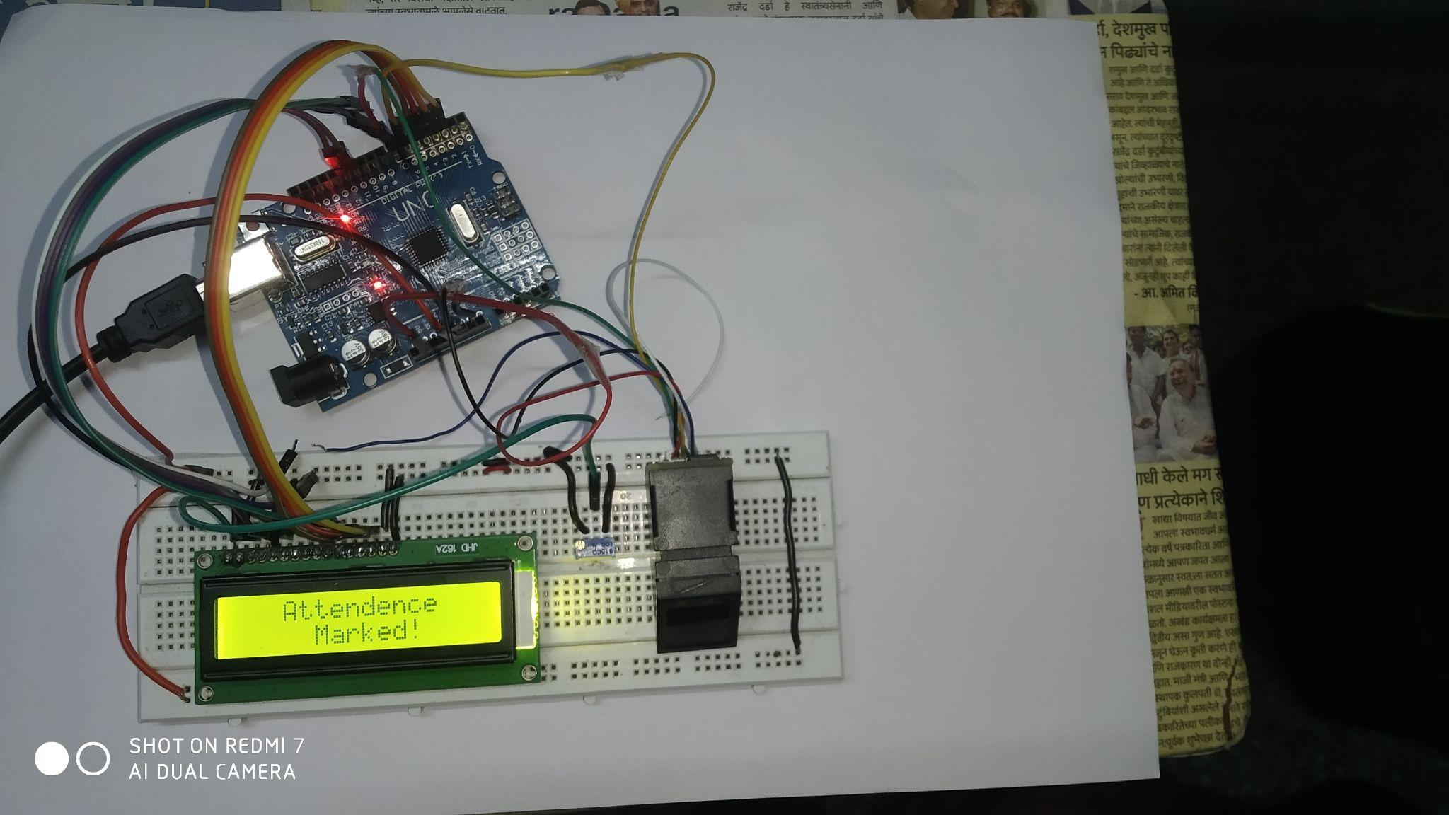
Result

Slide 10
Reference
[1] V. Yadav and G. P. Bhole, "Cloud Based Smart Attendance System for Educational Institutions," 2019 International Conference on Machine Learning, Big Data, Cloud and Parallel Computing (COMITCon), Faridabad, India, pp. 97-102, 2019.
[2] A. Chomklin, L. N. Nongkhai and P. Padungpattanadis, "Class Attendance Recording using QR Code via Smartphone," 2019 4th International Conference on Information Technology (InCIT), Bangkok, Thailand, pp. 173-178, 2019.

Slide 11
Thank you !

